Slide 1
Minor Project Real-Time Face Recognition Application

Slide 2
Preface
This project was created with intention of exploring the open source computer vision and machine learning software library. The area of computer vision, machine learning and artificial intelligence always fascinated us, so we decided to select face recognition as our minor project. We all were able to agree on this topic because we shared the same interest in this field. We researched various ways to implement our vision from the beginning of the project to its end.

Slide 3
Acknowledgement
We would like to thank our mentors, Dr.Salim Istyaq and Dr.Zahid Ahmed Ansari, who were constant source of inspiration. They encouraged us to think creatively and motivated us to work on this project without giving it a second thought. We are also thankful to every member of this group. It was each and every individual’s contribution that made this project a success. We were always there to lift each other up, and that was what helped us stay together till the end.

Slide 4
I n t r od u c t i on
This project is a real-time face recognition system made using Python to recognize faces in real-time, through Open-Source Computer Vision Library.
We used a Geometric (feature-based) approach to the face recognition problem. It is based on the geometrical relationship between facial landmarks, such as the eyes, nose, and mouth are first located and then faces are classified based on various geometrical distances and angles between features. GUI(Graphical User Interface) was implemented using Tkinter, which is a Python binding to the Tk GUI toolkit.

Slide 5
User Requirements
Software requirements-
-Python 3.11.0
-Python Imaging Library(PIL)
-OpenCV Library
Hardware requirements-
-Computer(4GB RAM or higher)
-Secondary memory to store images and data
-Camera
-Frame rate>=17fps
-Mega Pixels>=0.92
-Image Mode: RGB color

Slide 6
Approach

Slide 7
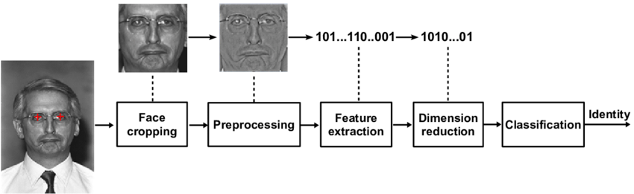
Feature based approach
In this method the eyes, nose, mouth are located and features are extracted which are feed to the structural classifier. The face extraction methods can be distinguished into
General methods based on eyes ears and nose
Feature-template based method
Structural matching methods ( geometrical Constraints on the features)

Slide 8
Data Structure and Algorithm

Slide 9
OpenCV Library
The OpenCV is a cross-platform library using which real-time computer vision applications can be developed. It mainly focuses on image processing, video capture and analysis including features like face detection and object detection.
Example:
clf = cv2.face.LBPHFaceRecognizer_create()

Slide 10
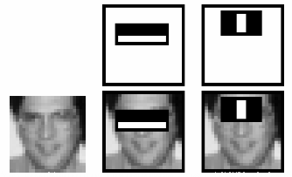
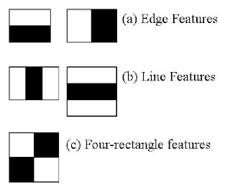
Haar Cascade Algorithm
The HAAR cascade is a machine learning approach where a cascade function is trained from a lot of positive and negative images. Positive images are those images that consist of faces, and negative images are without faces. In face detection, image features are treated as numerical information extracted from the pictures that can distinguish one image from another.
We apply every feature of the algorithm on all the training images. Every image is given equal weight at the starting. It founds the best threshold which will categorize the faces to positive and negative. There may be errors and misclassifications. We select the features with a minimum error rate, which means these are the features that best classifies the face and non-face images.
All possible sizes and locations of each kernel are used to calculate the plenty of features.

Slide 11
NumPy
NumPy stands for Numerical Python.
It also has functions for working in domain of linear algebra, fourier transform, and matrices.
NumPy was created in 2005 by Travis Oliphant. It is an open source project and you can use it freely.
NumPy is a Python library used for working with arrays.
Example: import numpy as np

Slide 12
PIL
The Python Imaging Library adds image processing capabilities to your Python interpreter.
This library provides extensive file format support, an efficient internal representation, and fairly powerful image processing capabilities.
The core image library is designed for fast access to data stored in a few basic pixel formats. It should provide a solid foundation for a general image processing tool.
Example: from PIL import Image

Slide 13
os
Python OS module provides the facility to establish the interaction between the user and the operating system. It offers many useful OS functions that are used to perform OS-based tasks and get related information about operating system. The OS comes under Python's standard utility modules.
Example: import os

Slide 14
Implementation

Slide 15
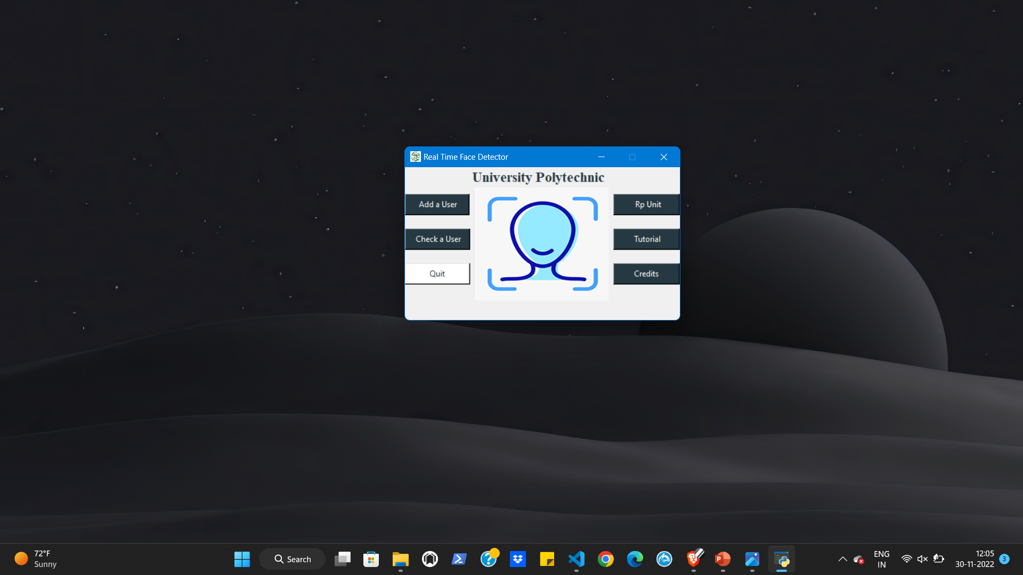
Front end using Tkinter
.

Slide 16
Tkinter
Front end of this project was implemented using the Tkinter.
Tkinter is the standard GUI library for Python.
Python when combined with Tkinter provides a fast and easy way to create GUI applications.
Tkinter provides a powerful object-oriented interface.
Tkinter provides various controls, such as buttons, labels and text boxes used in a GUI application called widgets.
GUI is mainly made up of seven windows, each of it customized according to the project needs.

Slide 17
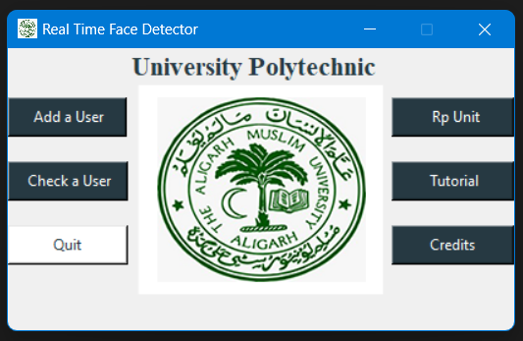
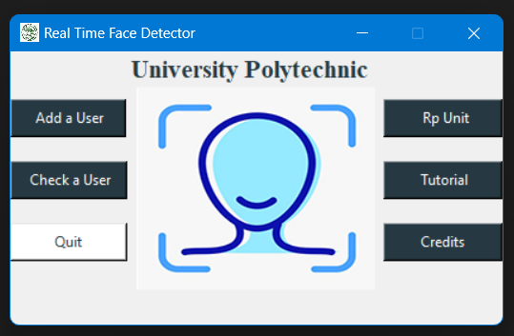
Opens the window for adding the name of the new user
Opens RP Unit’s website
on the default browser
Opens the window for selecting the user name from the dropdown menu
Opens the
Tutorial window
For exiting the application
Slide show
Opens the credit window
Home Page

Slide 18
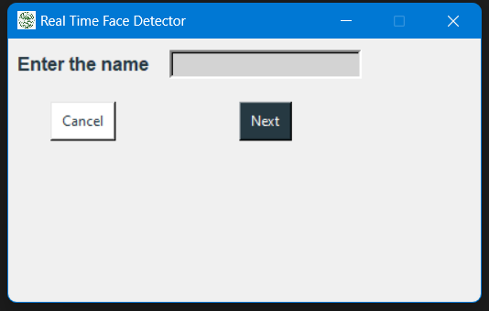
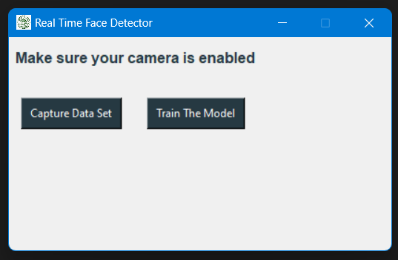
Entry widget for adding the name of the new user
For cancelling the process and going back to the Home Page
Opens the new window for capturing & training the data set for the new user
Opens the webcam which captures images of the new user
Opens the face recognition window after internal processing

Slide 19
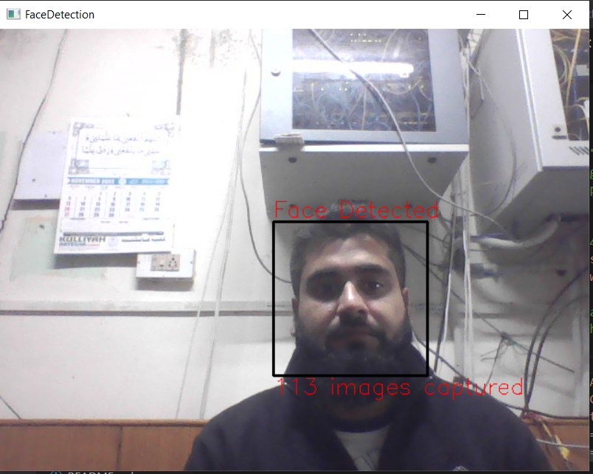
This window opens to capture the images of new user

Slide 20
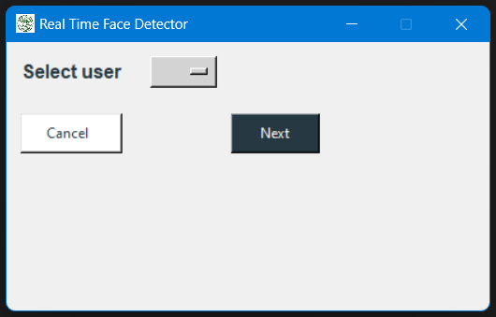
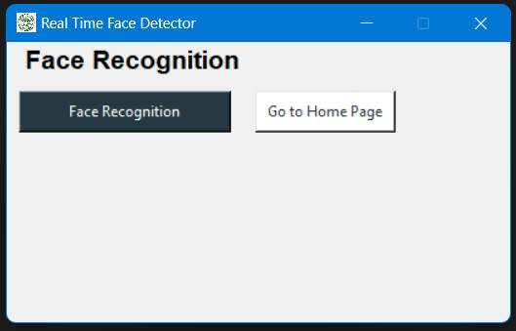
This window opens when the ‘Check User’ button on the home page is clicked
Select from the list of existing users
This window opens after selecting from the existing user or after training the dataset for a new user
For cancelling the process and going back to the Home Page
Opens
the Home Page
Opens another window for Face recognition
Opens the webcam and tries to recognize the user

Slide 21
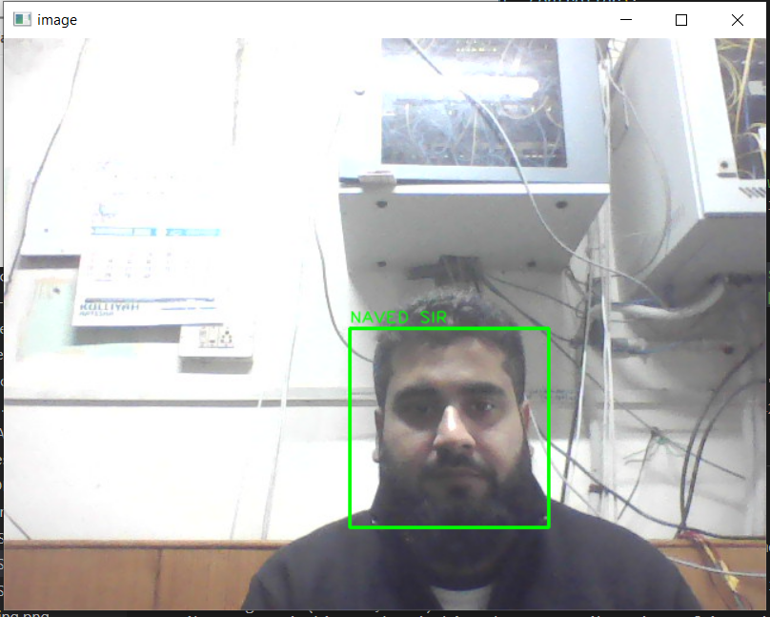
Thanks to Naved Sir
This window opens to recognize the existing user

Slide 22
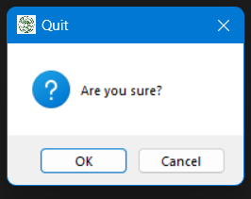
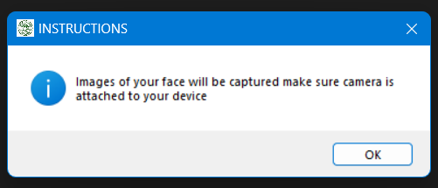
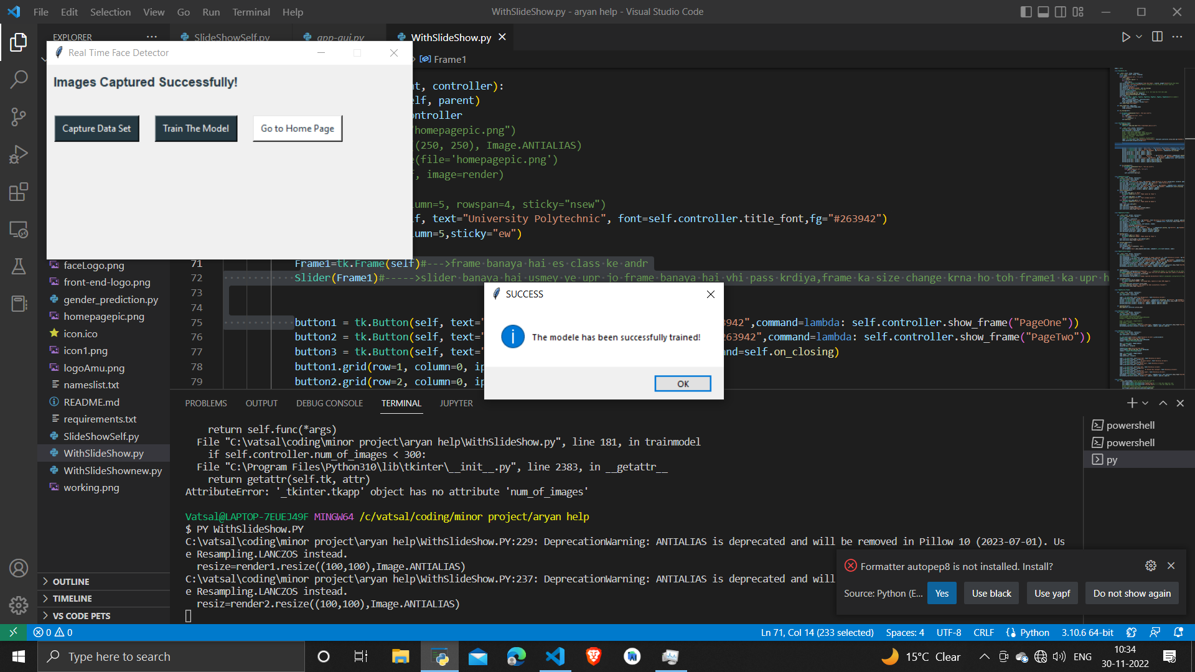
Message Box widget is used to display these message boxes.
This module is used to display a message using provides a number of functions.

Slide 23
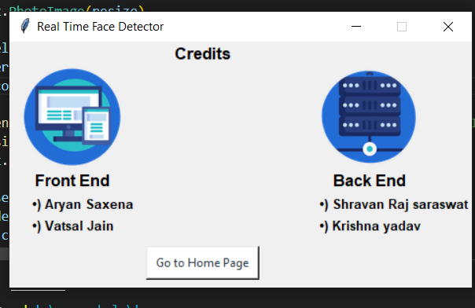
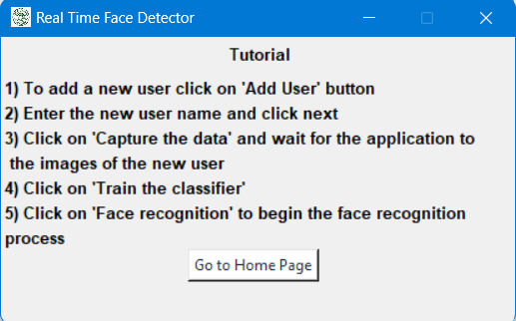
This window opens when the ‘Check User’ button on the home page is clicked
This window opens when the ‘Tutorial’ button on the home page is clicked
Opens
the Home Page
Opens
the Home Page

Slide 24
Advantages And Limitations

Slide 25
Advantages
It can be faster than other biometrics authentication methods.
It is easy to detect intruders.
Facial recognition is a more accurate way to identify individuals than simply using a mobile number, email address, mailing address, or IP address.

Slide 26
Limitations
It is not as accurate as other biometrics authentication methods.
It depends on the distance and pose of the face as well as the quality, and the illumination of the image/video used.
Accessories such as glasses or hats can negatively impact the accuracy of the system.
It is slow if it does not use live video footage for recognition.
Other biometrics authentication methods can be more accurate.
Intruders can abuse the system by wearing accessories to hide their identity
It has to use live video footage for recognition to be faster than other systems.

Slide 27
Applications

Slide 28
Applications
It can speed up the process of checking attendance at school/work.
It offers protection against intruders as they can be easily detected.
It can detect imposters who appear in the examination in place of the real candidates.

Slide 29
REFRENCES

Slide 30
Refrences
https://www.tutorialspoint.com/python/python_gui_programming.htm#:~:text=Tkinter%20is%20the%20standard%20GUI,Tkinter%20is%20an%20easy%20task.
https://www.geeksforgeeks.org/python-gui-tkinter/
https://opencv.org/
https://stackoverflow.com/
https://github.com/vatsaljain136/minor-project
https://docs.opencv.org/3.4/haar_features.jpg
https://docs.opencv.org/3.4/haar.png

